Slide 1

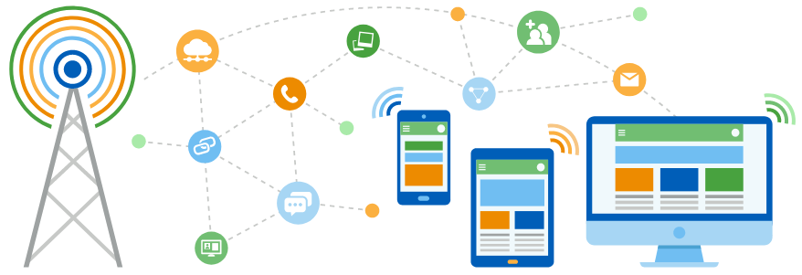
Faculty of Computing and Informatics
Department of Computer Science
IT Infrastructure Administration and Services
ITA711S
2023 - Semester 1
Event Specific Picture – behind red graphic
Chapter 6
Directory File System - LDAP

Slide 2
Outline
What is LDAP
How LDAP works
LDAP Structure

Slide 3
What is LDAP
Lightweight Directory Access Protocol (LDAP)
Defines a standard method for accessing and updating information in a directory.
Also used to refer to the directories being accessed
Many centralized database programs have been developed to allow users to log in on multiple computers using a single password
NIS was one of the first, but it doesn't encrypt the password transaction
It also uses the portmapper daemon, which uses an unpredictable range of TCP ports that are difficult for firewalls to track

Slide 4
What is LDAP
LDAP defines a communication protocol. That is, it defines the transport and format of messages used by a client to access data in an X.500-like directory
What is important is the logical model that is defined by data types, how the directory is organized, what operations are possible, how information is protected, etc.
Directories are organized under a common root directory in a tree hierarchy with different levels for each category of information, such as country, state, city, organization, organizational unit, person, machine, etc. in a worldwide scope.
Designed to provide a simpler yet robust implementation of X.500.

Slide 5
What is LDAP
LDAP can also interact with other login programs, such as Remote Authentication Dial-in User Service (RADIUS)
It was later recognized that LDAP had features that could make it a desirable replacement for NIS in some scenarios
For example, it uses a single TCP port (389) for regular communication and another port (636) for encrypted transactions
LDAP also can interact with many login authentication, authorization, and accounting programs external to UNIX.
  TACACS+ (Terminal Access Controller Access Control System Plus)
  RADIUS

Slide 6
How LDAP works
LDAP directory service is based on a client−server model.
One or more LDAP servers contain the data making up the LDAP directory tree or LDAP backend database.
An LDAP client connects to an LDAP server and asks it a question. The server responds with the answer, or with a pointer to where the client can get more information (typically, another LDAP server).
The LDAP server daemon is called Slapd. Slapd supports a variety of different database backends which one can use.
The LDAP information model is based on entries.An entry is a collection of attributes that has a globally-unique Distinguished Name (DN). The DN is used to refer to the entry.

Slide 7
LDAP Servers
OpenLDAP
• Active directory
• Apache Directory Server
• FreeIPA
• OpenDS
• Novell eDirectory
• Sun Java System Directory Server
• IBM Tivoli Directory Server

Slide 8
LDAP Structure
An object class defines the valid attributes and properties for an entry
A set of related object classes forms a schema. For example, you may have a schema to represent the users in a University Department.
Distinguished names similar to DNS.
Example: ou=People,dc=eurooscon,dc=example,dc=com

Slide 9
LDAP Structure
O stands for organization
OU stands for Organizational unit
SN stands for Surname
Givenname stands for First Name
UID stands for Userid
Mail stands for Email address
C stands for country
L stands for location
St stands for Status

Slide 10
Common uses of LDAP
User Directories: email addresses, students
User Accounts: Centralizing accounts, access control, groups
Inventory Catalogs: machines, offices
Network Service Backend: DNS, Email

Slide 11
Migrating user accounts to LDAP
Why do you want to do this?
To centralize user accounts
To modernize from some other network account store (e.g. NIS)
Eliminate duplication of data (already using LDAP for corporate address book?)
To better scale to the needs of a growing organization

Slide 12

End

